Slide 1
Framework of HCI

Slide 2
The field of ergonomics addresses issues on the user side of the interface, covering input and output, as well as the user‘s immediate context.
Dialog design and interface styles can be placed particularly along the input branch of the framework, addressing both articulation and performance.

Slide 3
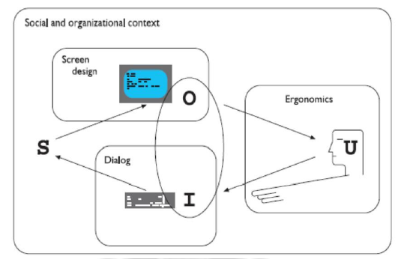
A framework for human–computer interaction

Slide 4
Presentation and screen design relates to the output branch of the framework.
The entire framework can be placed within a social and organizational context that also affects the interaction.
Each of these areas has important implications for the design of interactive systems and the performance of the user.

Slide 5
ERGONOMICS
Ergonomics (or human factors) is traditionally the study of the physical characteristics of the interaction: how the controls are designed, the physical environment in which the interaction takes place, and the layout and physical qualities of the screen.
A primary focus is on user performance and how the interface enhances or detracts from this.
In seeking to evaluate these aspects of the interaction, ergonomics will certainly also touch upon human psychology and system constraints.

Slide 6
It is a large and established field, which is closely related to but distinct from HCI, and full coverage would demand a book in its own right.
Here we consider a few of the issues addressed by ergonomics as an introduction to the field.
We will briefly look at the arrangement of controls and displays, the physical environment, health issues and the use of color.
These are by no means exhaustive and are intended only to give an indication of the types of issues and problems addressed by ergonomics.

Slide 7
Arrangement of controls and displays
The exact organization that this will suggest will depend on the domain and the application, but possible organizations include the following:
Functional controls and displays are organized so that those that are functionally related are placed together;
Sequential controls and displays are organized to reflect the order of their use in a typical interaction (this may be especially appropriate in domains where a particular task sequence is enforced, such as aviation);
Frequency controls and displays are organized according to how frequently they are used, with the most commonly used controls being the most easily accessible.

Slide 8
The physical environment of the interaction
Physical issues in the layout and arrangement of the machine interface, ergonomics is concerned with the design of the work environment itself.
This will depend largely on the domain and will be more critical in specific control and operational settings than in general computer use.
The physical environment in which the system is used may influence how well it is accepted and even the health and safety of its users.

Slide 9
It should therefore be considered in all design. The first consideration here is the size of the users.
Obviously this is going to vary considerably.
All users should be comfortably able to see critical displays. For long periods of use, the user should be seated for comfort and stability.
Seating should provide back support.
If required to stand, the user should have room to move around in order to reach all the controls.

Slide 10
Health issues
There are a number of factors that may affect the use of more general computers.
Again these are factors in the physical environment that directly affect the quality of the interaction and the user‘s.

Slide 11
Performance
Users should be able to reach all controls comfortably and see all displays.
Users should not be expected to stand for long periods and, if sitting, should be provided with back support.
If a particular position for a part of the body is to be adopted for long periods (for example, in typing) support should be provided to allow rest.

Slide 12
Temperature
Extremes of hot or cold will affect performance and, in excessive cases, health.
Experimental studies show that performance deteriorates at high or low temperatures, with users being unable to concentrate efficiently.

Slide 13
Lighting
The lighting level will again depend on the work environment.
adequate lighting should be provided to allow users to see the computer screen without discomfort or eyestrain.
The light source should also be positioned to avoid glare affecting the display.

Slide 14
Noise
Excessive noise can be harmful to health, causing the user pain, and in acute cases, loss of hearing.
Noise levels should be maintained at a comfortable level in the work environment.
This does not necessarily mean no noise at all. Noise can be a stimulus to users and can
provide needed confirmation of system activity.

Slide 15
Time
The time users spend using the system should also be controlled.
It has been suggested that excessive use of CRT displays can be harmful to users, particularly pregnant women.

Slide 16
The use of color
Colors used in the display should be as distinct as possible and the distinction should not be affected by changes in contrast.
Blue should not be used to display critical information.
If color is used as an indicator it should not be the only cue: additional coding information should be included.

Slide 17
The colors used should also correspond to common conventions and user expectations.
Red, green and yellow are colors frequently associated with stop, go and standby respectively.
Therefore, red may be used to indicate emergency and alarms; green, normal activity; and yellow, standby and auxiliary function.
These conventions should not be violated without very good cause.

Slide 18
Ergonomics and HCI
Ergonomics is a huge area, which is distinct from HCI but sits alongside it.
Its contribution to HCI is in determining constraints on the way we design systems and suggesting detailed and specific guidelines and standards.
Ergonomic factors are in general well established and understood and are therefore used as the basis for standardizing hardware designs.

